Slide 1



🌳 Tree Species Classification & Intelligence Assistant
BY DASU SWAPNIKA

Slide 2

🌳 Introduction
Tree species identification is important in forestry and environmental studies. Manual identification is difficult and time-consuming. This project uses deep learning to automatically classify tree species from leaf images using a web-based system.
🎯 Objectives
To classify tree species using leaf images
To use CNN-based deep learning for accurate prediction
To develop an easy-to-use web application for deployment
GOAL
Source :
www.freepik.com/

Slide 3
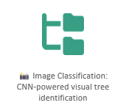
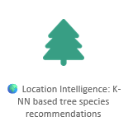
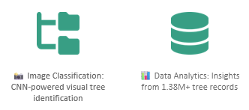
Tools & Technologies
Python
TensorFlow/Keras (MobileNetV2)
OpenCV, NumPy
Streamlit (Web app)
VS Code / PyCharm
GitHub (Project repository)
💡 What Each Does (Short & Simple)
Python: Main language used.
TensorFlow/Keras: Train and use the CNN model.
MobileNetV2: A lightweight pre-trained deep learning model for classification.
OpenCV/NumPy: Load and prepare images for the model.
Streamlit: Makes the model usable via browser.
run_project.bat: One-click way to launch the app.
GitHub: Stores and shares project code.

Slide 4
🔁 Methodology
Data Collection Tree leaf images are collected from a labeled dataset where each folder represents a tree species.
Image Preprocessing The images are resized to a fixed size (224×224), normalized, and prepared for model input.
Dataset Splitting The dataset is divided into training and validation sets to evaluate model performance.
Model Selection A Convolutional Neural Network (MobileNetV2) is selected using transfer learning for efficient feature extraction.
Model Training The CNN model is trained using the training dataset and optimized using the Adam optimizer.
Model Evaluation The model’s performance is evaluated using accuracy and validation metrics.
Deployment The trained model is deployed as a web application using Streamlit, allowing users to upload images and get predictions.

Slide 5
❗ Problem Statement
Identifying tree species manually using leaf images is difficult, time-consuming, and requires expert knowledge. There is a need for an automated system that can accurately identify tree species using image-based analysis.
🎯 Goal
The goal of this project is to develop a deep learning–based system that can automatically classify tree species from leaf images and provide results through a user-friendly web application.

Slide 6
🌳 Solution
I present TREE SPECIES CLASSIFICATION — an AI-based system that uses deep learning and image processing to automatically identify tree species from leaf images. The system simplifies traditional identification by providing fast, accurate, and user-friendly predictions through a web application.
🚀 Key Features
📷 Image-based classification Classifies tree species using uploaded leaf images with a CNN model.
🧠 Deep learning powered Uses a Convolutional Neural Network (MobileNetV2) for accurate feature extraction and prediction.
⚡ Fast and accurate results Provides real-time predictions with high accuracy.
🌐 Web-based application Built using Streamlit with a clean and interactive user interface.
🖱️ Easy to use Users can upload images and get results without technical knowledge.
🔗 Scalable system Can be extended to include more tree species and additional image types.

Slide 7
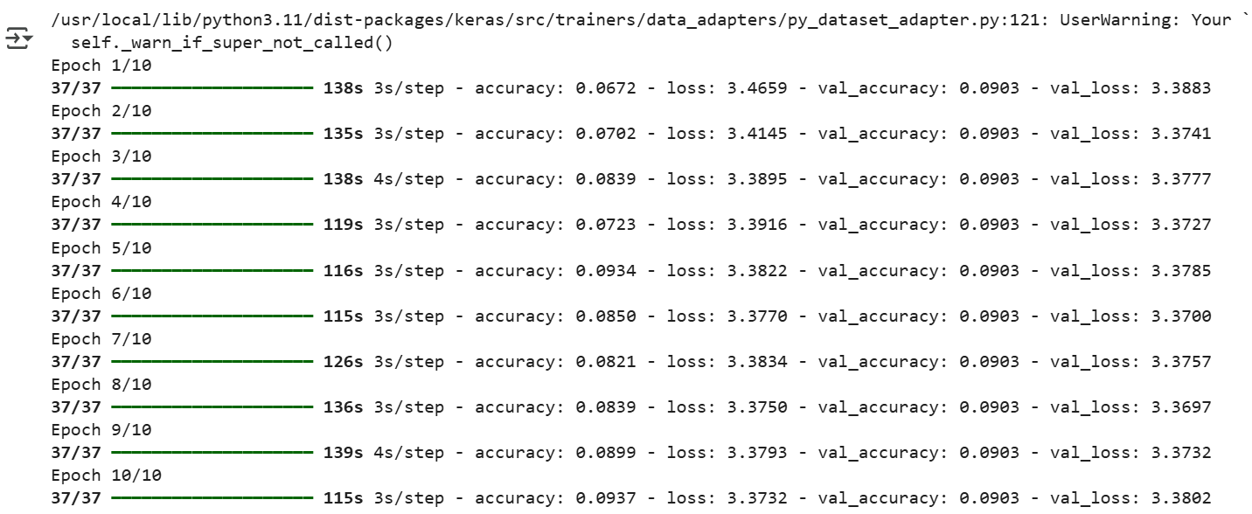
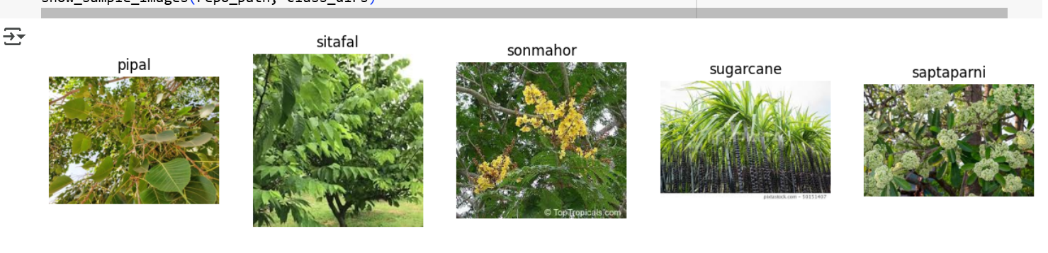
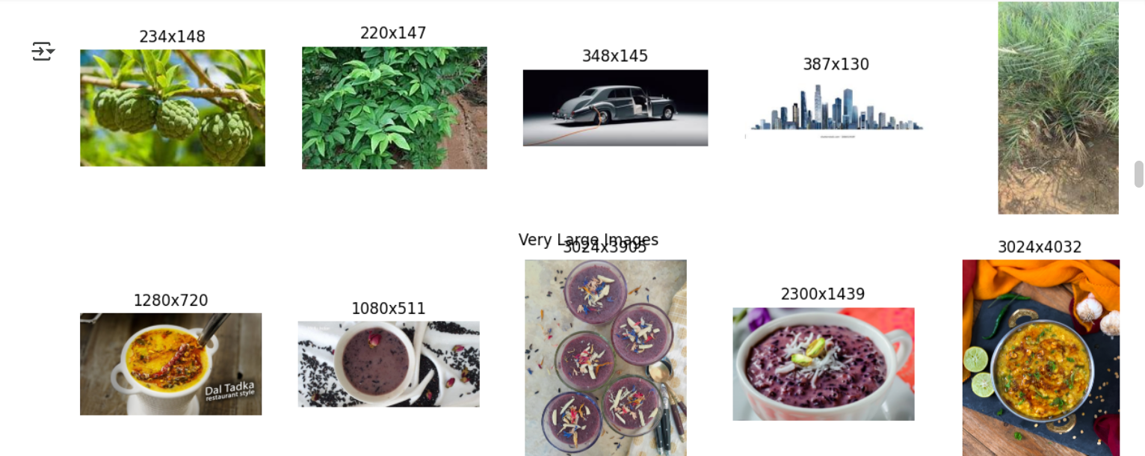
Screenshot of Output:

Slide 8
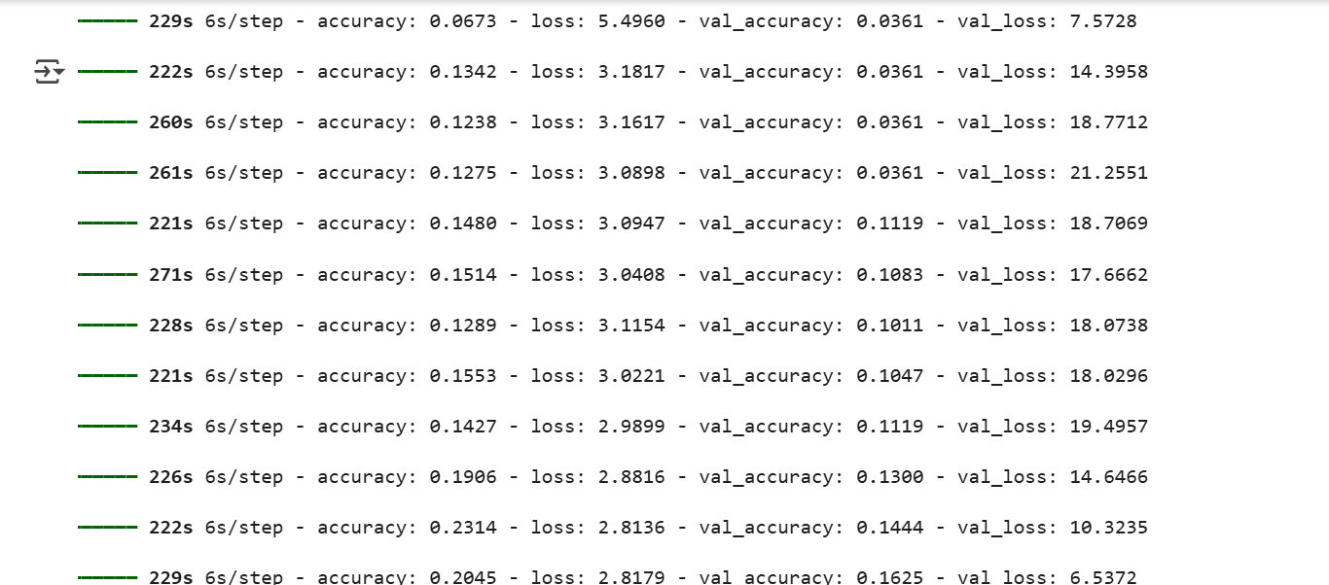
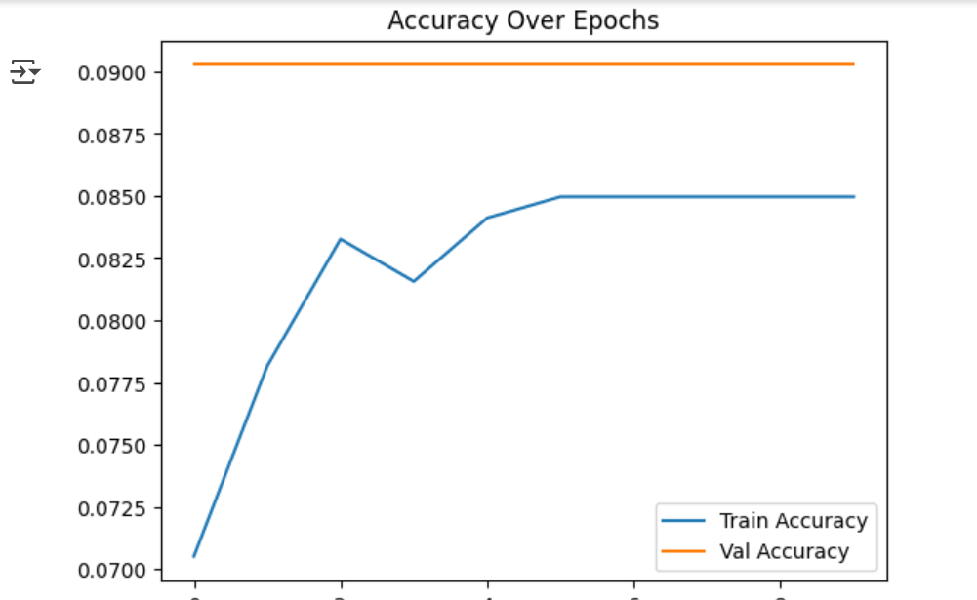

Slide 9
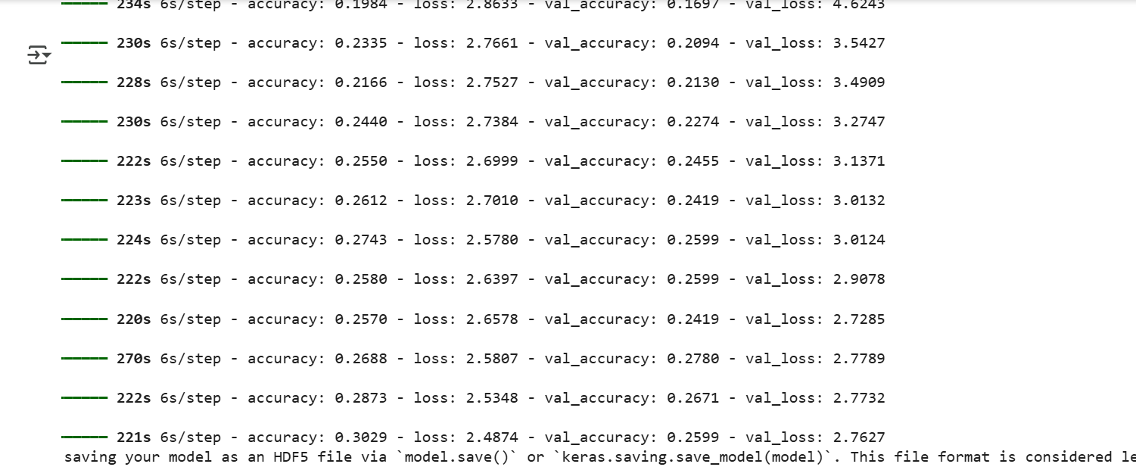

Slide 10
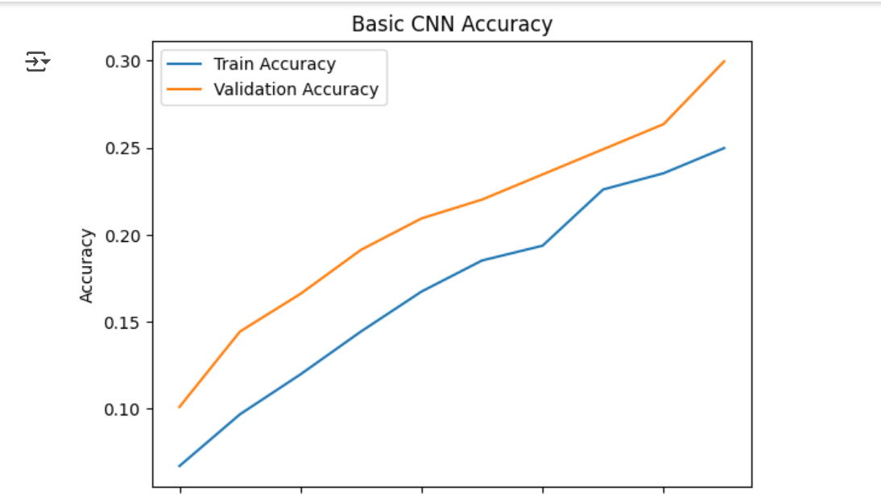

Slide 11
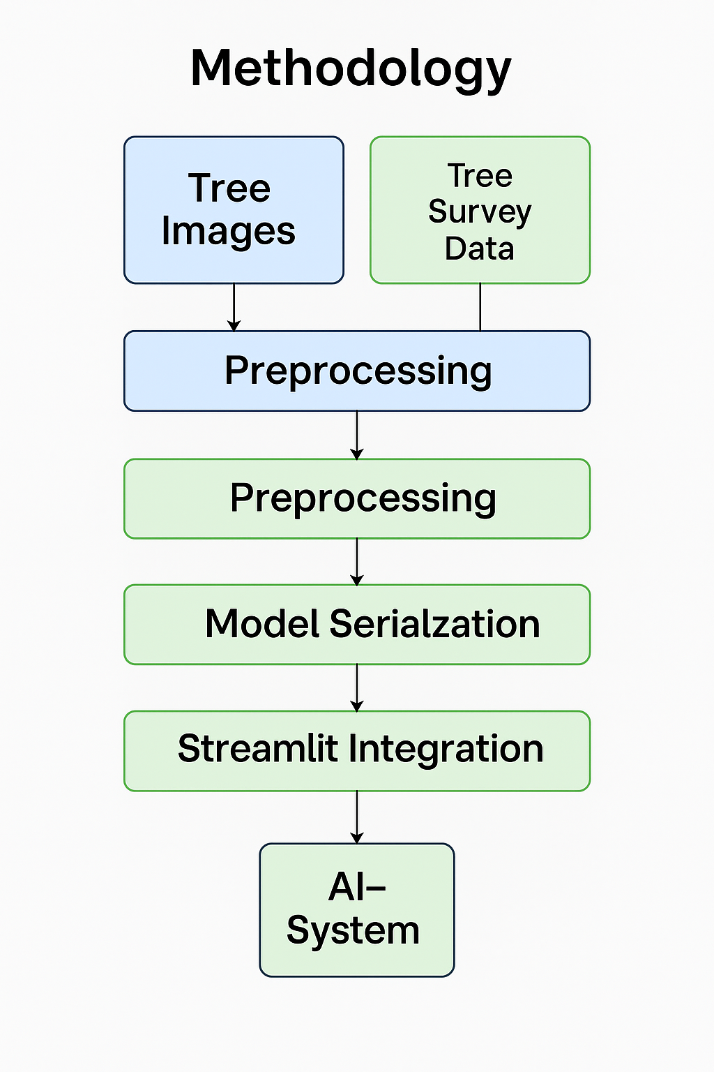
📁 Final Project Structure
Tree_Species_Classification/
│
├── dataset/
│ ├── train/
│ │ ├── species_1/
│ │ ├── species_2/
│ │ └── species_n/
│ │
│ └── test/
│
├── app.py # Streamlit web application
├── train_model.py # Model training script
├── predict.py # Prediction script
├── tree_species_model.h5 # Trained CNN model
├── run_project.bat # One-click project launcher
├── requirements.txt # Required libraries
├── README.md # Project documentation
└── Project_Report.pdf # Project report

Slide 12
✅ Conclusion
In this project, a Tree Species Classification System was successfully developed using deep learning techniques. The system accurately identifies tree species from leaf images using a Convolutional Neural Network (CNN). By deploying the model as a web-based application, the project provides an easy and efficient way for users to classify tree species without expert knowledge. This approach reduces manual effort, improves accuracy, and demonstrates the practical application of AI in environmental and forestry studies.

